Slide 1
Business Intelligence G. Mudare

Slide 2
Rule-Based Classification
IN rule-based classifiers, the learned model is represented as a set of IF-THEN rules.
First examine how such rules are used for classification.
There are ways that can be generated, either from a decision tree or directly from the training data using a sequential covering algorithm.

Slide 3
Using IF-THEN Rules for Classification
A rule-based classifier uses a set of IF-THEN rules for classification. And is an expression of the form:
IF condition THEN conclusion.
An example is rule R1,
R1:
IF age = youth AND student = yes THEN buys computer = yes.

Slide 4
Using IF-THEN Rules for Classification
The “IF”-part of a rule the rule antecedent or precondition.
The “THEN”-is the rule consequent.
In the rule antecedent, the condition consists of one or more attribute tests (such as age = youth, and student = yes) that are logically ANDed.
The rule’s consequent contains a class prediction
R1 can also be written as
R1: IF age = youth AND student = yes THEN buys computer = yes.

Slide 5
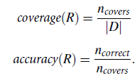
Using IF-THEN Rules for Classification
If the condition in a rule antecedent holds true for a given tuple,
→rule antecedent is satisfied and that the rule covers the tuple.
rule R can be assessed by its coverage and accuracy.
Given a tuple, X, from a class labelled data set,D, let n_{covers} be the number of tuples covered by R;
ncorrect be the number of tuples correctly classified by R; and |D| be the number of tuples in D.
Define the coverage and accuracy of R as

Slide 6
Using IF-THEN Rules for Classification
a rule’s coverage is the percentage of tuples that are covered by the rule
For a rule’s accuracy, we look at the tuples that it covers and see what percentage of them the rule can correctly classify.

Slide 7
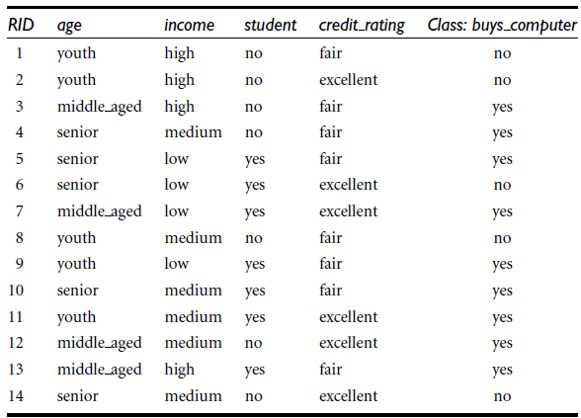

Using IF-THEN Rules for Classification
Example: Rule accuracy and coverage
From the table,these are class-labelled tuples from a customer database.
Our task is to predict whether a customer will buy a computer.
R1: IF age = youth AND student = yes THEN buys computer = yes.
R1 covers 2 of the 14 tuples.
It can correctly classify both tuples. Therefore,
coverage(R1) = 2/14 = 14:28% and accuracy
(R1) = 2/2 = 100%.

Slide 8
Using IF-THEN Rules for Classification
How can we use rule-based classification to predict the class label of a given tuple, X?
If a rule is satisfied by X, the rule is said to be triggered
Classify X according to buys computer.
X satisfies R1, which triggers the rule.
If R1 is the only rule satisfied, then the rule fires by returning the class prediction for X.
Note that triggering does not always mean firing because there may be more than one rule that is satisfied!
If more than one rule is triggered, we have a potential problem.

Slide 9
Using IF-THEN Rules for Classification
What if they each specify a different class?
Or what if no rule is satisfied by X?
first question.
If more than one rule is triggered, we need a conflict resolution strategy to figure out which rule gets to fire and assign its class prediction to X.
There are many possible strategies.
size ordering
rule ordering.

Slide 10
size ordering
The size ordering scheme assigns the highest priority to the triggering rule that has the “toughest” requirements,
Toughness is measured by the rule antecedent size.( the triggering rule with the most attribute tests is fired)
Overall the rules are unordered.
They can be applied in any order when classifying a tuple. (disjunction (logical OR) is implied between each of the rules.
Each rule represents a stand-alone nugget or piece of knowledge.

Slide 11
Rule ordering.
The rule ordering scheme prioritizes the rules beforehand.
The ordering may be class based or rule-based.
With class-based ordering, the classes are sorted in order of decreasing “importance,” such as by decreasing order of prevalence. (all of the rules for the most prevalent class come first, the rules for the next prevalent class come next, and so on.)
They may also be sorted based on the misclassification cost per class.
With rule-based ordering, the rules are organized into one long priority list, according to some measure of rule quality such as accuracy, coverage, or size, or based on advice from domain experts.
When rule ordering is used, the rule set is known as a decision list.
With rule ordering, the triggering rule that appears earliest in the list has highest priority, and so it gets to fire its class prediction.
Any other rule that satisfies X is ignored.
Most rule-based classification systems use a class-based rule-ordering strategy.

Slide 12
Rule ordering.
The rule-ordering (decision list) scheme rules must be applied in the prescribed order so as to avoid conflicts.
Each rule in a decision list implies the negation of the rules that come before it in the list.
Hence, rules in a decision list are more difficult to interpret.

Slide 13
size ordering scheme
The size ordering scheme assigns the highest priority to the triggering rule that has the “toughest” requirements, where toughness is measured by the rule antecedent size. That is, the triggering rule with the most attribute tests is fired.
Triggering rule: A rule whose antecedent (the "if" part) matches the current example.
Toughest requirement: The rule with the strictest or most specific conditions.
Rule antecedent size: The number of attribute tests in the rule’s condition (e.g., R1: IF Age = youth AND Student = yes THEN Buys_computer = yes has size 2).
Size ordering scheme: When several rules match, you choose the one with the largest antecedent size (i.e., the most conditions).

Slide 14
size ordering scheme
R1: IF Age = youth AND Student = yes THEN Buys_computer = yes (antecedent size = 2)
R2: IF Income = high THEN Buys_computer = no (antecedent size = 1)
R3: IF Age = middle-aged THEN Buys_computer = yes (antecedent size = 1)
Conflict Resolution: Size Ordering Scheme
R1 antecedent size = 2
R2 antecedent size = 1
R1 preferred (more specific, “tougher” conditions).
Final classification: Buys_computer = yes.
Size ordering prefers the most specific rule when multiple rules apply.
triggered Rules:
R1: matches (Age = youth, Student = yes)
R2: matches (Income = high)
R3: does not match (Age ≠ middle-aged)

Slide 15
class-based ordering
In class-based ordering (sometimes called class priority ordering), we don’t look at the size of the rule antecedent, but instead at the importance of the class that the rule predicts.
The classes are ranked beforehand, often by:Prevalence (most frequent class comes first),
Domain importance (e.g., “Buys_computer” more important than “not-Buys_computer”),
Or some other external criterion.
When multiple rules are triggered, the rule predicting the highest-ranked class is preferred.

Slide 16
Example with AllElectronics
Determine class importance by prevalence in the training data. Imagine the class distribution is:
Buys_computer = no → 9 cases
Buys_computer = yes → 5 cases
importance order is: No > Yes.
Rules
R1: IF Age = youth AND Student = yes THEN Buys_computer = yes
R2: IF Income = high THEN Buys_computer = no
Both R1 and R2 fire.
R1 predicts Yes
R2 predicts No
Using Class-Based Ordering
Class importance order: No > Yes
R2 is preferred (because it predicts the more important class, even though R1 is more specific)
.Final classification: Buys_computer = no.
Size ordering → prefers the most specific rule.
Class-based ordering → prefers the rule predicting the most important class.

Slide 17
misclassification cost
Another common criterion is the misclassification cost per class.
Some classes are costlier to misclassify than others.
Let’s assume misclassification costs:
Predicting No when actual is Yes → Cost = 5 (lost customer)
Predicting Yes when actual is No → Cost = 1 (wasted marketing effort)
Rules
R1: IF Age = youth AND Student = yes THEN Buys_computer = yes
R2: IF Income = high THEN Buys_computer = no
Both R1 and R2 fire:
R1 → predicts Yes
R2 → predicts No
Conflict Resolution by Misclassification Cost Ordering
Yes class is more important (higher misclassification cost).
R1 preferred.

Slide 18
Determining the class label of X Where no rule satisfied by X
A fallback or default rule can be set up to specify a default class, based on a training set.
This may be the class in majority or the majority class of the tuples that were not covered by any rule.
The default rule is evaluated at the end,
if and only if no other rule covers X.
The condition in the default rule is empty. →the rule fires when no other rule is satisfied.

Slide 19
Determining the class label of X?
Decision tree classifiers are a popular method of classification—
it is easy to understand how decision trees work and they are known for their accuracy.
Decision trees can become large and difficult to interpret.
We want to look at how to build a rule based classifier by extracting IF-THEN rules from a decision tree.
In comparison with a decision tree, the IF-THEN rules may be easier for humans to understand, particularly if the decision tree is very large.
To extract rules from a decision tree, one rule is created for each path from the root to a leaf node.
Each splitting criterion along a given path is logically ANDed to form the rule antecedent (“IF” part).
The leaf node holds the class prediction, forming the rule consequent (“THEN” part).

Slide 20
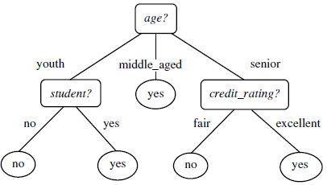
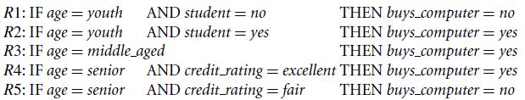
Extracting classification rules from a decision tree
The decision tree can be converted to classification IF-THEN rules by tracing the path from the root node to each leaf node in the tree.
A disjunction (logical OR) is implied between each of the extracted rules Because the rules are extracted directly from the tree, they are mutually exclusive and exhaustive(no conflicts)..

Slide 21
How can we prune the rule set?”
For a given rule antecedent, any condition that does not improve the estimated accuracy of the rule can be pruned (i.e., removed), thereby generalizing the rule.
Problems arise during rule pruning, however, as the rules will no longer be mutually exclusive and exhaustive

Slide 22
Rule Induction Using a Sequential Covering Algorithm
IF-THEN rules can be extracted directly from the training data (i.e., without having to generate a decision tree first) using a sequential covering algorithm.
Sequential covering algorithms are the most widely used approach to mining disjunctive sets of classification rules,
Classification rules can be generated using associative classification algorithms, which search for attribute-value pairs that occur frequently in the data.
These pairs may form association rules, which can be analysed and used in classification.
Rules are learned one at a time.
Each time a rule is learned, the tuples covered by the rule are removed, and the process repeats on the remaining tuples.

Slide 23
RID | Age | Income | Student | Credit_Rating | Class: Buys_Computer
1 | youth | high | no | fair | no
2 | youth | high | no | excellent | no
3 | Middle_Aged | high | no | fair | yes
4 | Senior | Medium | no | fair | yes
5 | Senior | Low | yes | fair | yes
6 | Senior | Low | yes | excellent | no
7 | Middle_Aged | Low | yes | excellent | yes
8 | youth | Medium | no | fair | no
9 | youth | Low | yes | fair | yes
10 | Senior | Medium | yes | fair | yes
11 | youth | Medium | yes | excellent | yes
12 | Middle_Aged | Medium | no | excellent | yes
13 | Middle_Aged | high | yes | fair | yes
14 | Senior | Medium | no | excellent | no

Slide 24
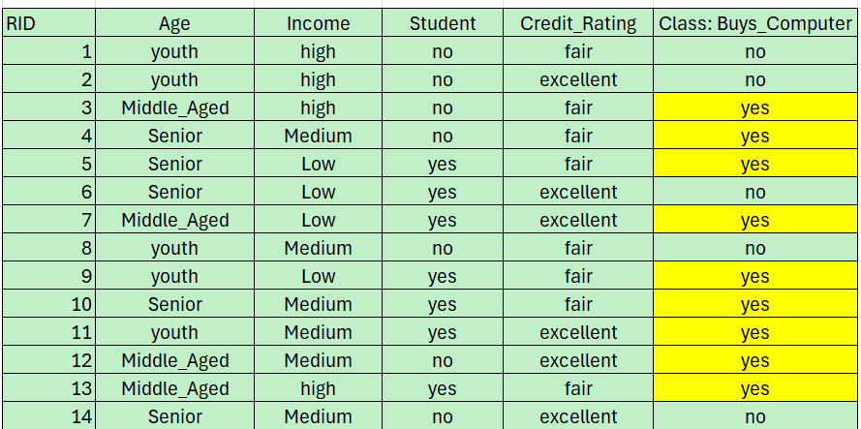
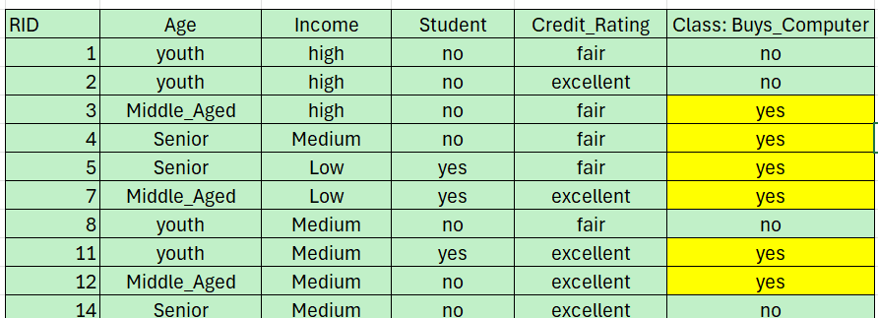
Sequential Covering Algorithm
Positive examples = Buys_Computer = Yes
Negative examples = Buys_Computer = No
Goal: Generate IF-THEN rules that cover all positive examples without covering negatives.
Algorithm:
Start with all positive examples.
Pick an attribute-value combination that covers some positives and no negatives.
Add it as a rule.Remove covered positives.
Repeat until all positives are covered.
Step 3
First rule
Consider Student=Yes AND Credit_rating=Fair
Covers positives: Rows 5, 9, 10, 13
Covers negatives? Row 6 → Credit_rating=Excellent (doesn’t match) Good
Rule 1: IF Student=Yes AND Credit_rating=Fair THEN Buys_Computer=Yes
Remove positives: 5, 9, 10, 13
Remaining positives: Rows 3, 4, 7, 12, 11

Slide 25
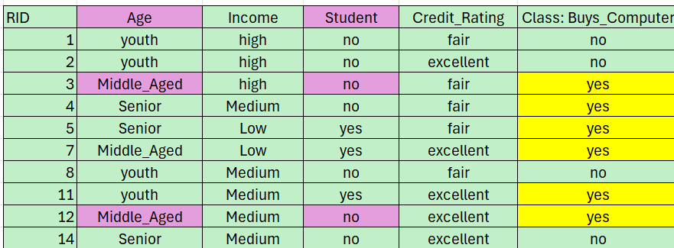
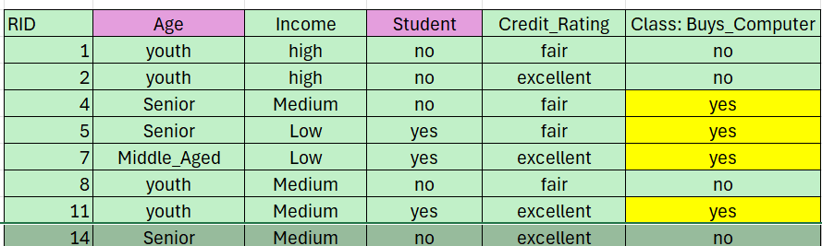
Sequential Covering Algorithm
Second rule
Consider Age=Middle-aged AND Student=No
Covers positives: 3, 12
Negatives? Row 2? Age=Youth → no conflict
Rule 2: IF Age=Middle-aged AND Student=No THEN Buys_Computer=Yes
Remove positives: 3, 12
Remaining positives: 4,5 ,7, 11

Slide 26
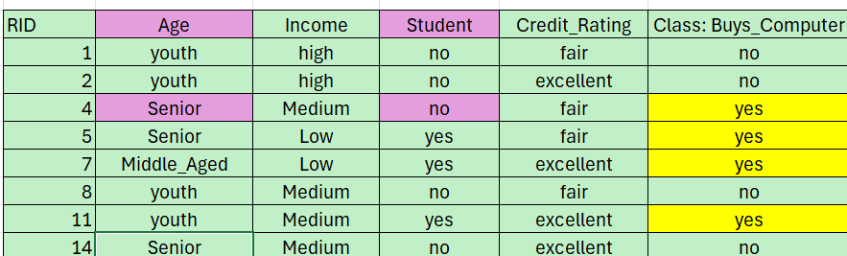
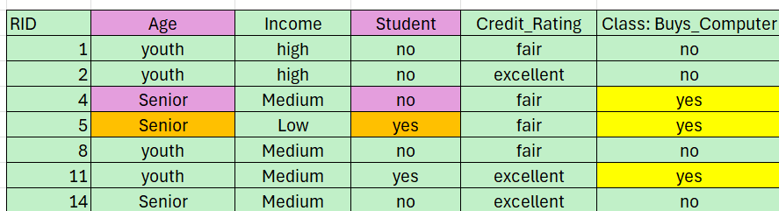
Sequential Covering Algorithm
Third rule
Consider Age=Senior AND Student=No
Covers positive: 1
Covers negatives? Row 14 → Senior, Student=No → Negative → Cannot
Consider Age=Senior AND Student=Yes
Covers positive: 5
Consider Age=Middle-aged AND Student=Yes
Covers positive: 7
Rule 3: IF Age=Middle-aged AND Student=Yes THEN Buys_Computer=Yes
Remove positives: 7,
Remaining positive: 4 ,5,11

Slide 27
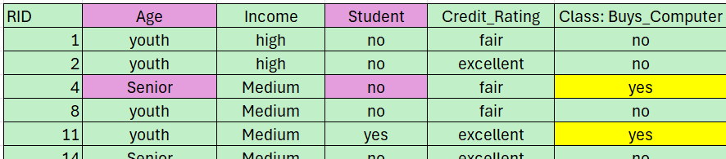
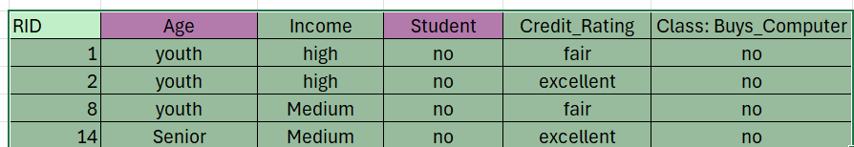
Sequential Covering Algorithm
Fourth rule
Only positive left: Row 4 → Age=Senior, Income=Medium, Student=No, Credit_rating=Fair
Rule 4: IF Age=Senior AND Student=No AND Credit_rating=Fair THEN Buys_Computer=Yes
Rule 5: IF Age=youth AND Student=yes AND Credit_rating=Excellent THEN Buys_Computer=Yes
Step 4: Final Rule Set
R1: IF Student=Yes AND Credit_rating=Fair THEN Buys_Computer=Yes
R2: IF Age=Middle-aged AND Student=No THEN Buys_Computer=Yes
R3: IF Age=Middle-aged AND Student=Yes THEN Buys_Computer=Yes
R4: IF Age=Senior AND Student=No AND Credit_rating=Fair THEN Buys_Computer=Yes
All positives are covered; no negatives are wrongly classified.

Slide 28
Rule Induction Using a Sequential Covering Algorithm
A basic sequential covering algorithm is that, rules are learned for one class at a time.
Ideally, when learning a rule for a class, Ci, we would like the rule to cover all (or many) of the training tuples of class C and none (or few) of the tuples from other classes.
The rules learned should be of high accuracy.
The rules need not necessarily be of high coverage. (different rules may cover different tuples within the same class.)
Process continues until the terminating condition is met, such as when there are no more training tuples or the quality of a rule returned is below a user-specified threshold.
The Learn One Rule procedure finds the “best” rule for the current class, given the current set of training tuples.

Slide 29
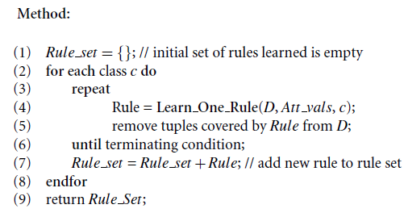
Basic sequential covering algorithm.

Slide 30
“How are rules learned?
Rules are grown in a general-to-specific manner
Start off with an empty rule and then gradually keep appending attribute tests to it.
Append by adding the attribute test as a logical conjunct to the existing condition of the rule antecedent

Slide 31
Example
Suppose our training set, D, consists of loan application data.
Attributes regarding each applicant include their age, income, education level, residence, credit rating, and the term of the loan.
The classifying attribute is loan decision, which indicates whether a loan is accepted (considered safe) or rejected (considered risky).
To learn a rule for the class “accept,” we start off with the most general rule possible, that is, the condition of the rule antecedent is empty.
IF THEN loan decision = accept.
then consider each possible attribute test that may be added to the rule

Slide 32
General-to-specific search through rule space.
Attibute values can be derived from the parameter Att vals, which contains a list of attributes with their associated values.
Eg For an attribute-value pair (att, val), consider
Attribute tests such as att = val, att < val, att > val,
The training data will contain many attributes, each of which may have several possible values.
Finding an optimal rule set becomes computationally explosive.
Learn One Rule adopts a greedy depth-first strategy.
Each time it is faced with adding a new attribute test (conjunct) to the current rule, it picks the one that most improves the rule quality, based on the training samples.( say we use rule accuracy as our quality measure)

Slide 33
General-to-specific search through rule space.
suppose Learn One Rule finds that the attribute test income = high best improves the accuracy of our current (empty) rule.
We append it to the condition, so that the current rule becomes
IF income = high THEN loan decision = accept.
Each time we add an attribute test to a rule, the resulting rule should cover more of the “accept” tuples.
During the next iteration, we again consider the possible attribute tests and end up selecting credit rating = excellent.
Our current rule grows to become
IF income = high AND credit rating = excellent THEN loan decision = accept
Process repeats, where at each step, we continue to greedily grow rules until the resulting rule meets an acceptable quality level.

Slide 34
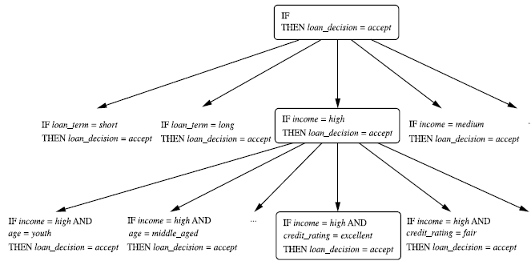
A general-to-specific search
through rule space

Slide 35
General-to-specific search through rule space.
Greedy search does not allow for backtracking.
At each step, we heuristically add what appears to be the best choice at the moment.
To lessen the chance of a poor choice along the way, instead of selecting the best attribute test to append to the current rule, we can select the best k attribute tests.
this way, we perform a beam search of width k wherein we maintain the k best candidates overall at each step, rather than a single best candidate.

Slide 36
Rule Quality Measures
Learn One Rule needs a measure of rule quality.
Every time it considers an attribute test, it must check to see if appending such a test to the current rule’s condition will result in an improved rule.
Accuracy may seem like an obvious choice at first,

Slide 37
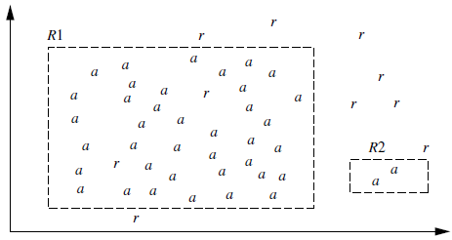
Rule Quality Measures
Use “a” to represent the tuples of class “accept” and “r” for the tuples of class “reject.” Rule R1 correctly classifies
38 of the 40 tuples it covers.
Rule R2 covers only two tuples, which it correctly classifies. Their respective accuracies are 95% and 100%.
R2 has greater accuracy than R1,but it is not the better rule because of its small coverage.

Slide 38
Rule Quality Measures
Accuracy on its own is not a reliable estimate of rule quality.
Coverage on its own is not useful either—for a given class we could have a rule that covers many tuples, most of which belong to other classes!
seek other measures for evaluating rule quality, which may integrate aspects of accuracy and coverage.
Other measures include:
entropy,
information gain,
statistical test that considers coverage.
By using Other measures we want to see if R10 is any better than R’.

Slide 39
Rule Quality Measures
Entropy in information gain measure is used for attribute selection in decision tree induction and is also known as the expected information needed to classify a tuple in data set, D. where , D is the set of tuples covered by condition’ and pi is the probability of class Ci in D.
The lower the entropy, the better condition’ is.
Entropy prefers conditions that cover a large number of tuples of a single class and few tuples of other classes.

Slide 40

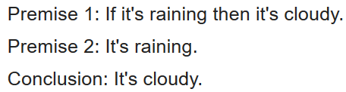
Rule Quality Measures
Another measure is based on information gain and was proposed in FOIL (First Order Inductive Learner), a sequential covering algorithm that learns first-order logic rules.
Learning first-order rules is more complex because such rules contain variables, whereas the rules we are concerned with are propositional (i.e., variable-free).

Slide 41

Rule Quality Measures
The tuples of the class for which we are learning rules are called positive tuples, while the remaining tuples are negative.
Let pos (neg) be the number of positive (negative) tuples covered by R.
Let pos’ (neg’) be the number of positive (negative) tuples covered by R’. FOIL assesses the information gained by extending condition as
It favors rules that have high accuracy and cover many positive tuples.

Slide 42

Rule Quality Measures
Use a statistical test of significance to determine if effect of a rule is not attributed to chance but indicates a genuine correlation between attribute values and classes.
Test compares the observed distribution among classes of tuples covered by a rule with the expected distribution that would result if the rule made predictions at random.
Assess whether any observed differences between two distributions may be attributed to chance.
Use the likelihood ratio statistic,
m is the number of classes. For tuples satisfying the rule,
fi is the observed frequency of each class i among the tuples. ei is what we would expect the frequency of each class i to be if the rule made random predictions

Slide 43
Rule Quality Measures
Statistic has a χ2 distribution with m -1 degrees of freedom.
The higher the likelihood ratio is, the more likely that there is a significant difference in the number of correct predictions made by our rule in comparison with a “random guessor.”
That is, the performance of the rule is not due to chance.
The ratio helps identify rules with insignificant coverage.

Slide 44
Rule Pruning
Learn One Rule does not employ a test set when evaluating rules.
Assessments of rule quality are made with tuples from the original training data.
Assessment is optimistic because the rules will likely overfit the data. ( the rules may perform well on the training data, but less well on subsequent data.)
To compensate for this, we can prune the rules.
A rule is pruned by removing a conjunct (attribute test).
choose to prune a rule, R, if the pruned version of R has greater quality, as assessed on an independent set of tuples.

Slide 45

Rule Pruning
Various pruning strategies can be used, such as the pessimistic pruning approach
FOIL uses a simple yet effective method.
where pos and neg are the number of positive and negative tuples covered by R, respectively.
This value will increase with the accuracy of R on a pruning set.
if the FOIL Prune value is higher for the pruned version of R, then we prune R.
Conjuncts are pruned one at a time as long as this results in an improvement.

